Slide 1
Validated Parsing of Regular Expressions in Agda
Computer Science
University of Birmingham

Slide 2
Project Objectives
Objective :
To learn and apply dependent types
Why Automata Theory
Model of Computation in second year
The proofs are non-trivial

Slide 3
Project Overview
Translating from regular expressions to automata
Regex -> Minimal DFA
Proving their correctness in Agda
∀e. L(e) = L(regexToMDFA e)
MDFA is minimal

Slide 4
Agda
Dependently typed programming language
Dependent type
A type that is indexed by values of other types
Vec Nat n e.g. Vec Nat 1 , Vec Nat 10
Gives more precise types
e.g. Binary search tree
Related to predicate logic

Slide 5
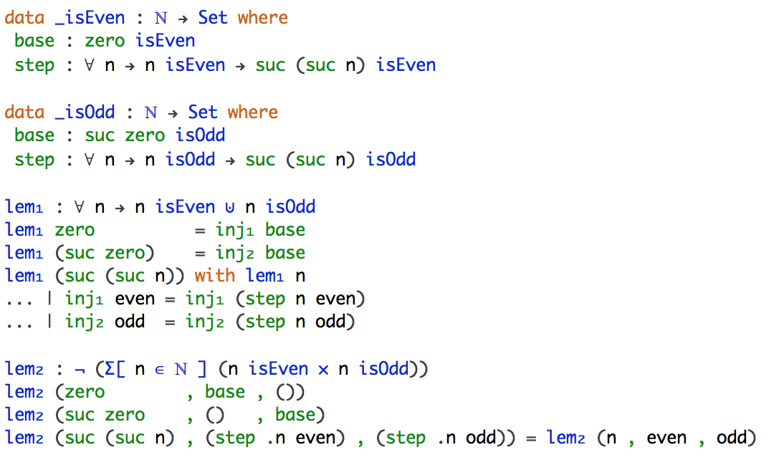
Agda
Encoding predicate logic

Slide 6
Agda
Dependently typed programming language
Dependent type
A type that is indexed by a value of other type
Vec Nat n e.g. Vec Nat 1 , Vec Nat 10
Gives more precise types
e.g. Binary search tree
Related to predicate logic
Proof assistant
Write programs
Prove their correctness

Slide 7
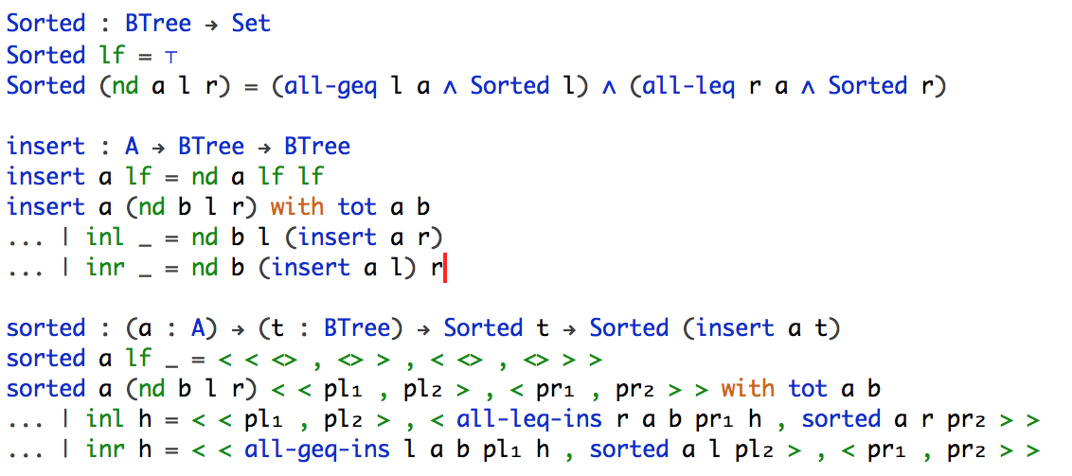
Agda
Encoding specification of program

Slide 8
Project Overview
Translating from regular expressions to automata
Regex -> Minimal DFA
Proving their correctness in Agda
∀e. L(e) = L(regexToMDFA e)
MDFA is minimal
Focus on the correctness only but NOT the efficiency of the algorithm

Slide 9
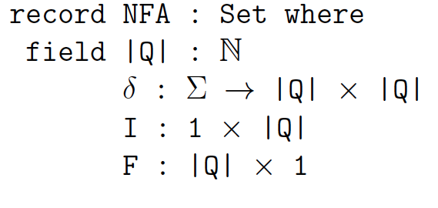
Related Work
Certified Parsing of Regular Languages
By Firsov, D. and Uustalu, T. (2013)
Translated Regex to NFA using Thompsons’ construction
Proved the correctness

Slide 10
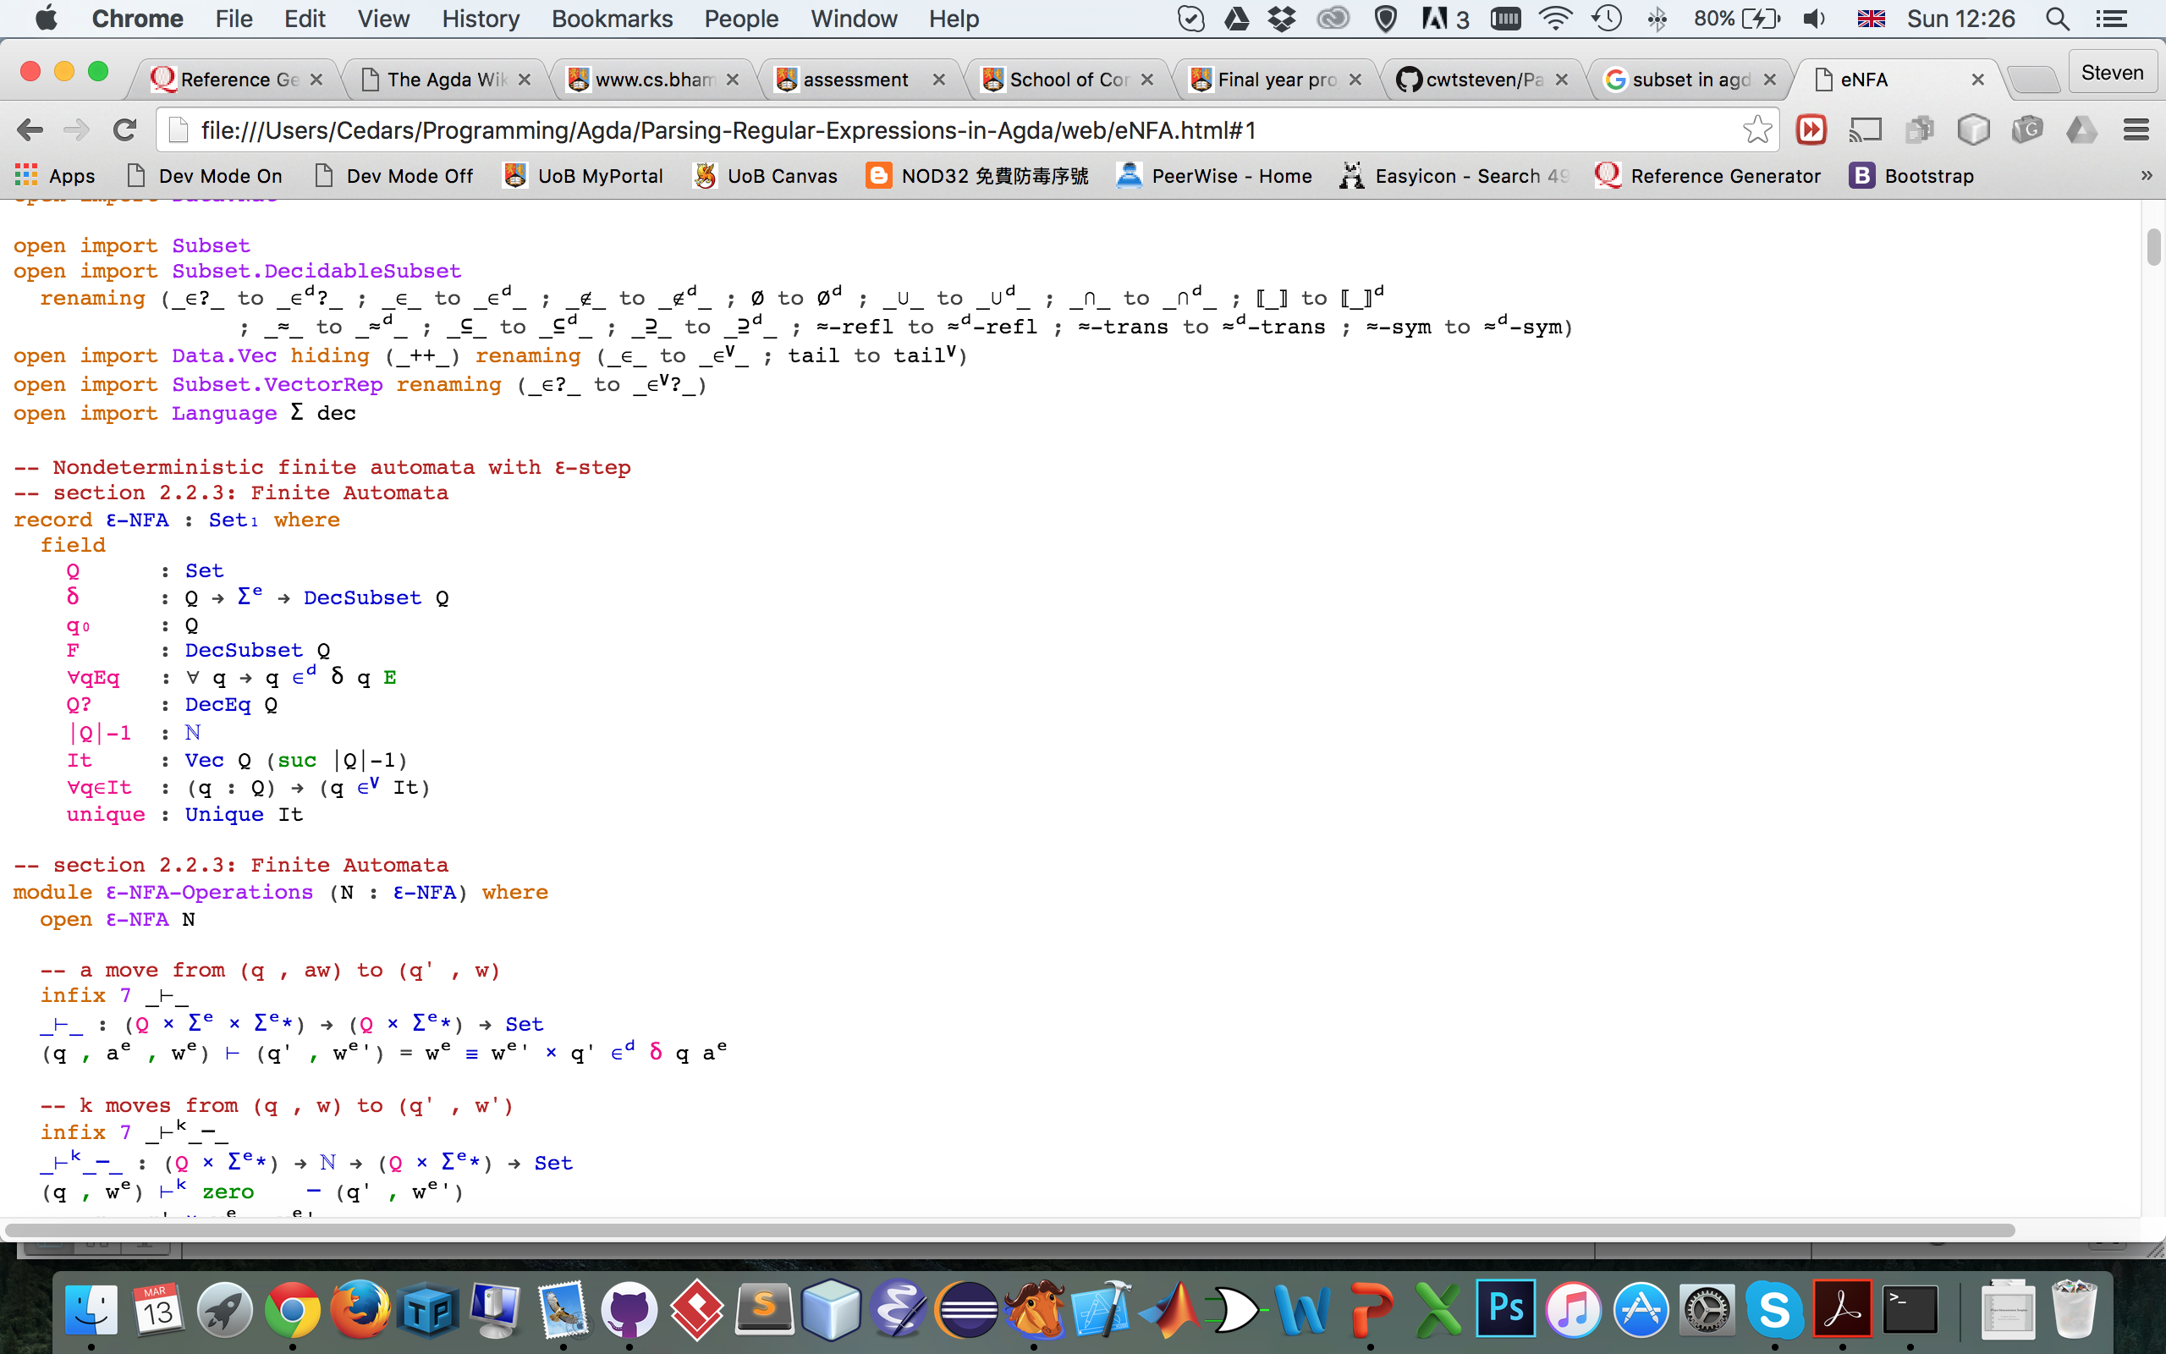
Our Approach
Regex -> Minimal DFA
Different representation
Q : Set
Subset = Q -> Bool

Slide 11
Our Approach
Regex -> MDFA
Thompsons’ construction
Removing ε-transitions
Powerset construction
Removing unreachable states
Quotient construction
Correctness Proofs
L(Regex) = L(ε-NFA) = L(NFA) = L(DFA) = L(MDFA)
MDFA is minimal
All states are reachable
MDFA is irreducible

Slide 12
Evaluation
Correctness
To convince the readers that the statement is correct
Readability
To explain why the statement is correct

Slide 13
Evaluation
Representation of abstract objects
Subset Q (set of states)
Vector
Q -> Bool

Slide 14
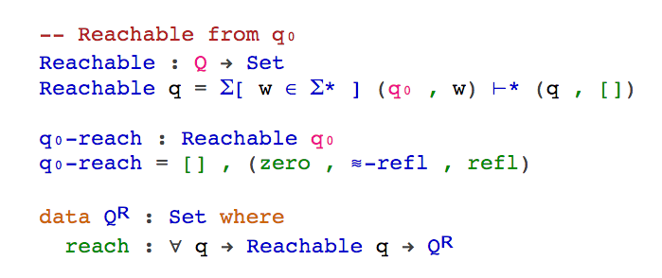
Evaluation
Problem arises

Slide 15
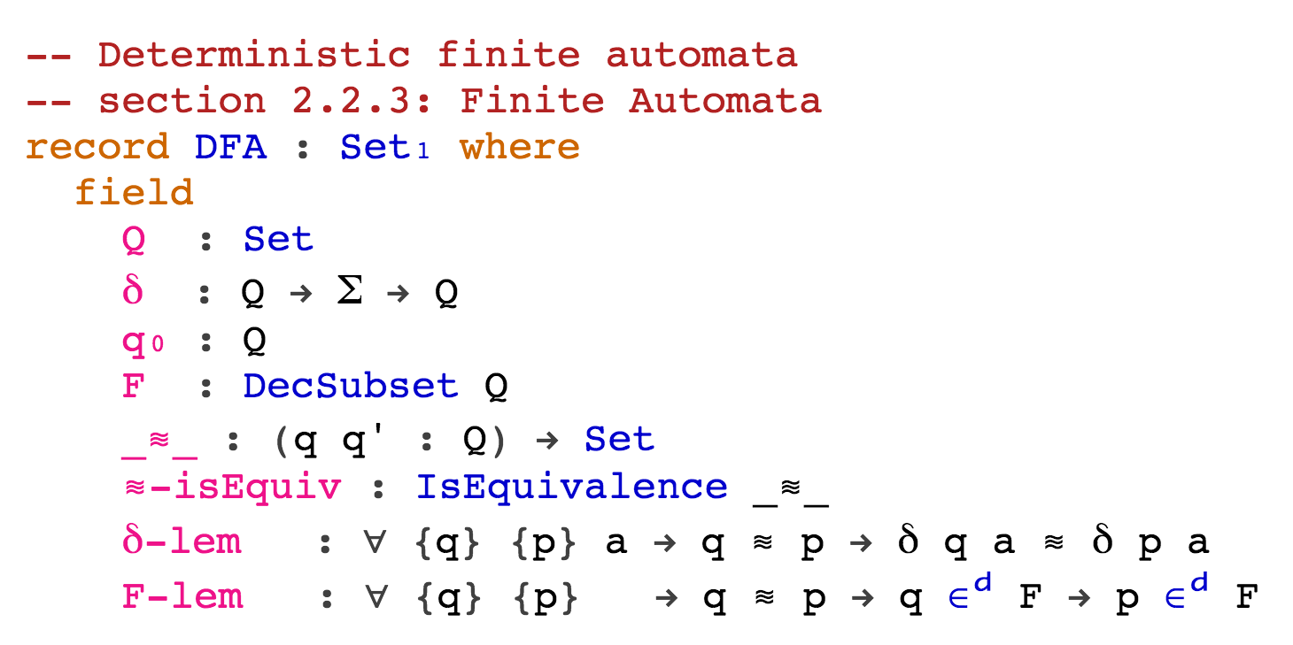
Evaluation

Slide 16
Work Done
Formalising Regular Expression and Automata
Define Subset and its operations ✓
Define Regular Expression and Automata ✓
Define the translation
Thompson’s construction ✓
Removing ε-transitions ✓
Powerset construction ✓
Removing unreachable states ✓
Minimisation (table filling algorithm) 80%
Correctness Proofs
L(Regex) = L(ε-NFA) ✓
L(ε-NFA) = L(NFA) ✓
L(NFA) = L(DFA) ✓
L(DFA) = L(MDFA) 80%
MDFA is minimal ✓

Slide 17
Further Extensions
Myhill-Nerode Theorem
To prove that a Language is regular
Pumping Lemma
To prove that a Language is NOT regular

Slide 18
Conclusion
Feasible to formalise mathematics or programming logic in Type Theory
Difficulties
Non-structural recursion

Slide 19
References
[1] Alfred V. Aho and Jeery V. Ullman. The theory of parsing, translation and compiling. volume i: Parsing, 1972.
[2] Ana Bove and Peter Dybjer. Dependent types at work. In LERNET 2008. LNCS , pages 57-99. Springer, 2009.
[3] Denis Firsov and Tarmo Uustalu. Certied parsing of regular languages, 2013.
[4] H. Geuvers. Proof assistants: history, ideas and future, 2009.
[5] Ulf Norell and James Chapman. Dependently typed programming in agda. In Lecture Notes from the Summer School in Advanced Functional Programming , 2008.

Slide 20
Q & A

Slide 21
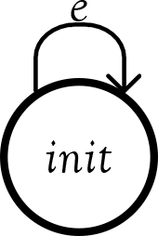

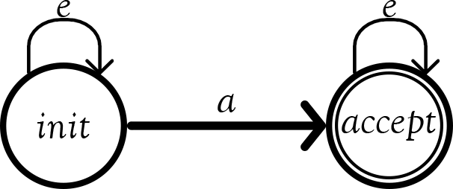
Thompson’s construction
Null
Epsilon
Singleton

Slide 22
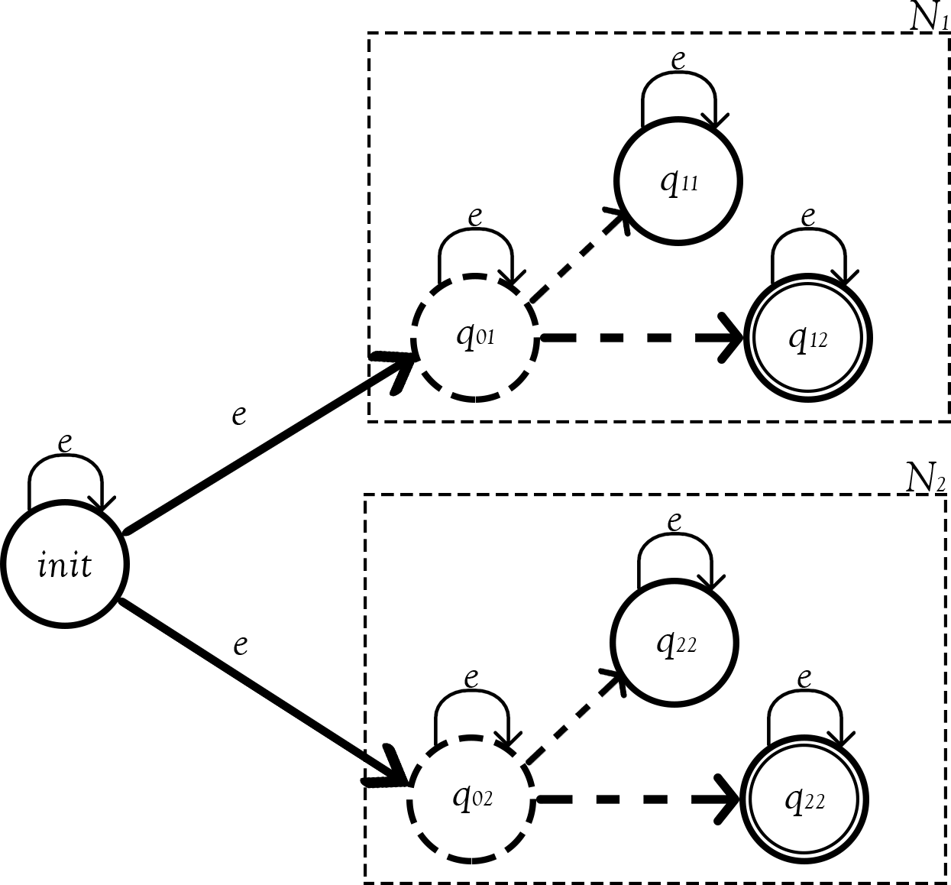
Thompson’s construction
Union

Slide 23
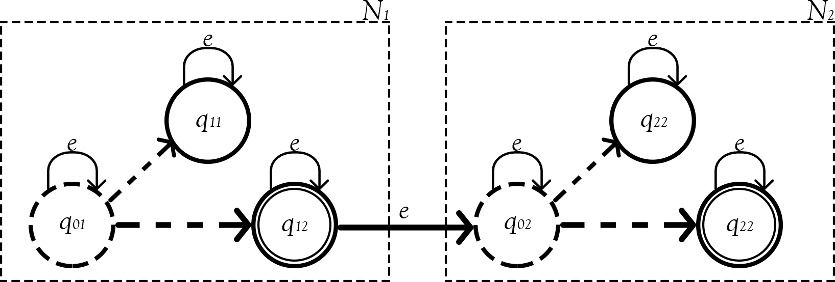
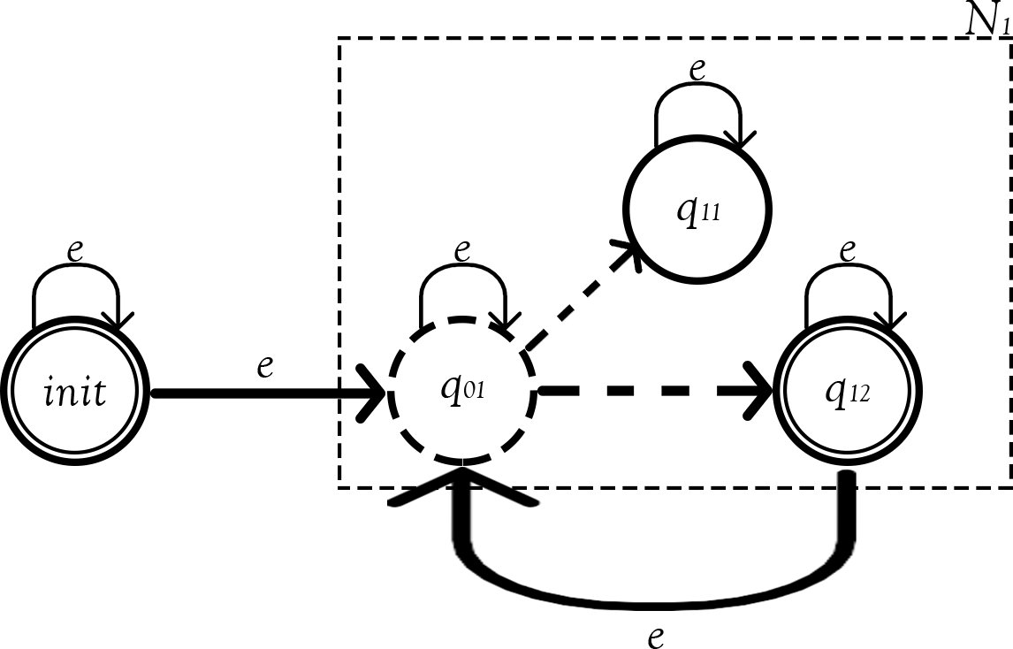
Thompson’s construction
Concatenation
Kleen star

Slide 24
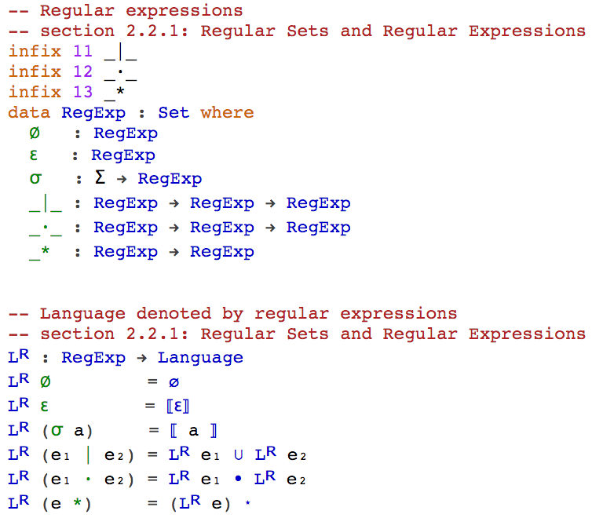
Regex → ε-NFA
Define Regular Expression
Notes:
Here we dene regular expressions inductively over Σ as follow:
1. ∅ is a regular expression denoting the regular language ;
2. ε is a regular expression denoting the regular language {ε} ;
3. ∀a∈Σ. A is a regular expression denoting the regular language {a} ;
4. if e₁ and e₂ are regular expressions denoting the regular languages L₁ and L₂ respectively, then
(a) e₁ | e₂ is a regular expressions denoting the regular language L₁∪ L₂;
(b) e₁ ∙ e₂ is a regular expression denoting the regular language L₁ ∙ L₂;
(c) e₁ * is a regular expression denoting the regular language L₁*.

Slide 25
Regex → ε-NFA
Define ε-NFA
An ε-NFA is a 5-tuple M = (Q, Σ^{e}, δ, q₀ , F), where
1. Q is a finite set of states;
2. Σ^{e} is the union of Σ and {ε};
3. δ is a mapping from Q × Σ^{e} to P(Q) which defines the behaviour of the automata;
4. q₀ in Q is the initial state;
5. F ⊆ Q is the set of accepting states.

Slide 26
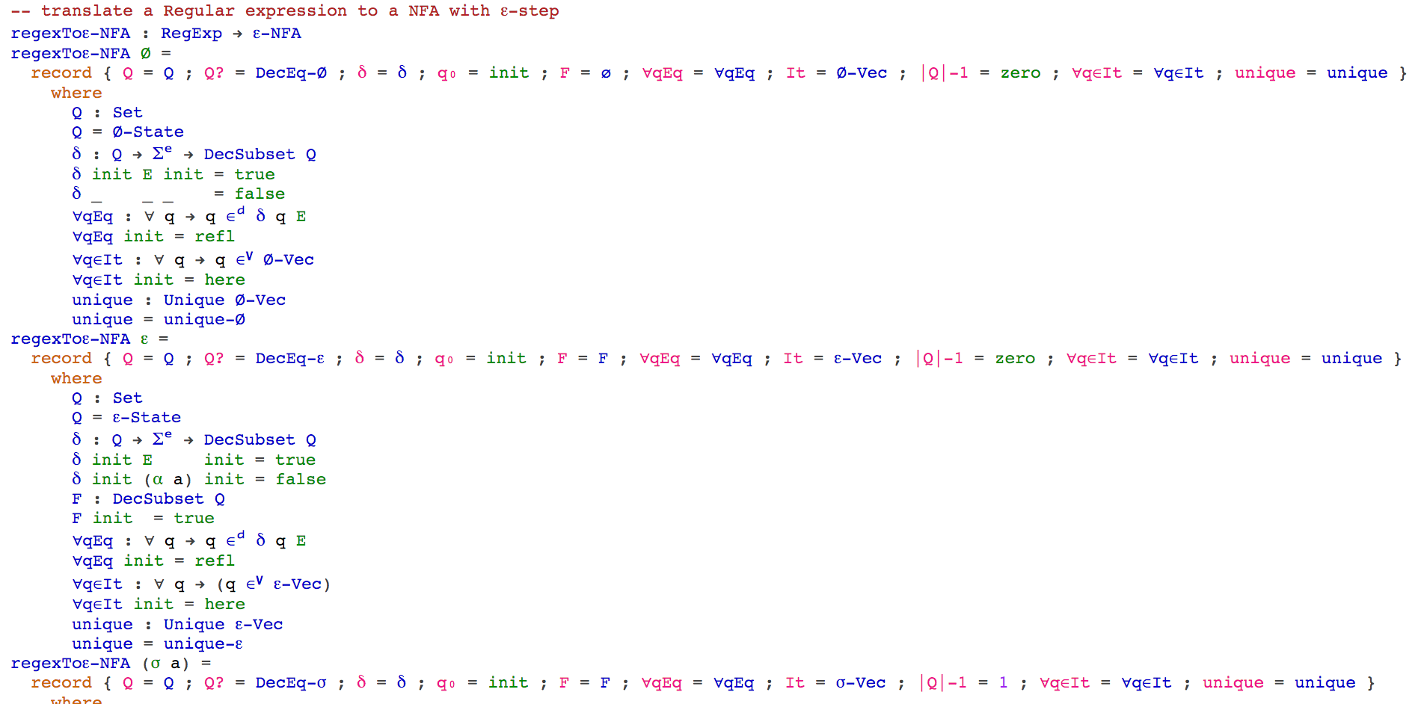
Regex → ε-NFA
Define the translation (Regex → ε-NFA)

Slide 27
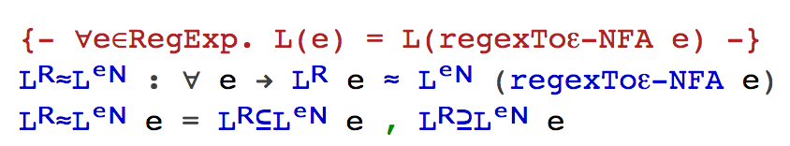
Regex → ε-NFA
L(regex) = L(translated ε-NFA)

Slide 28
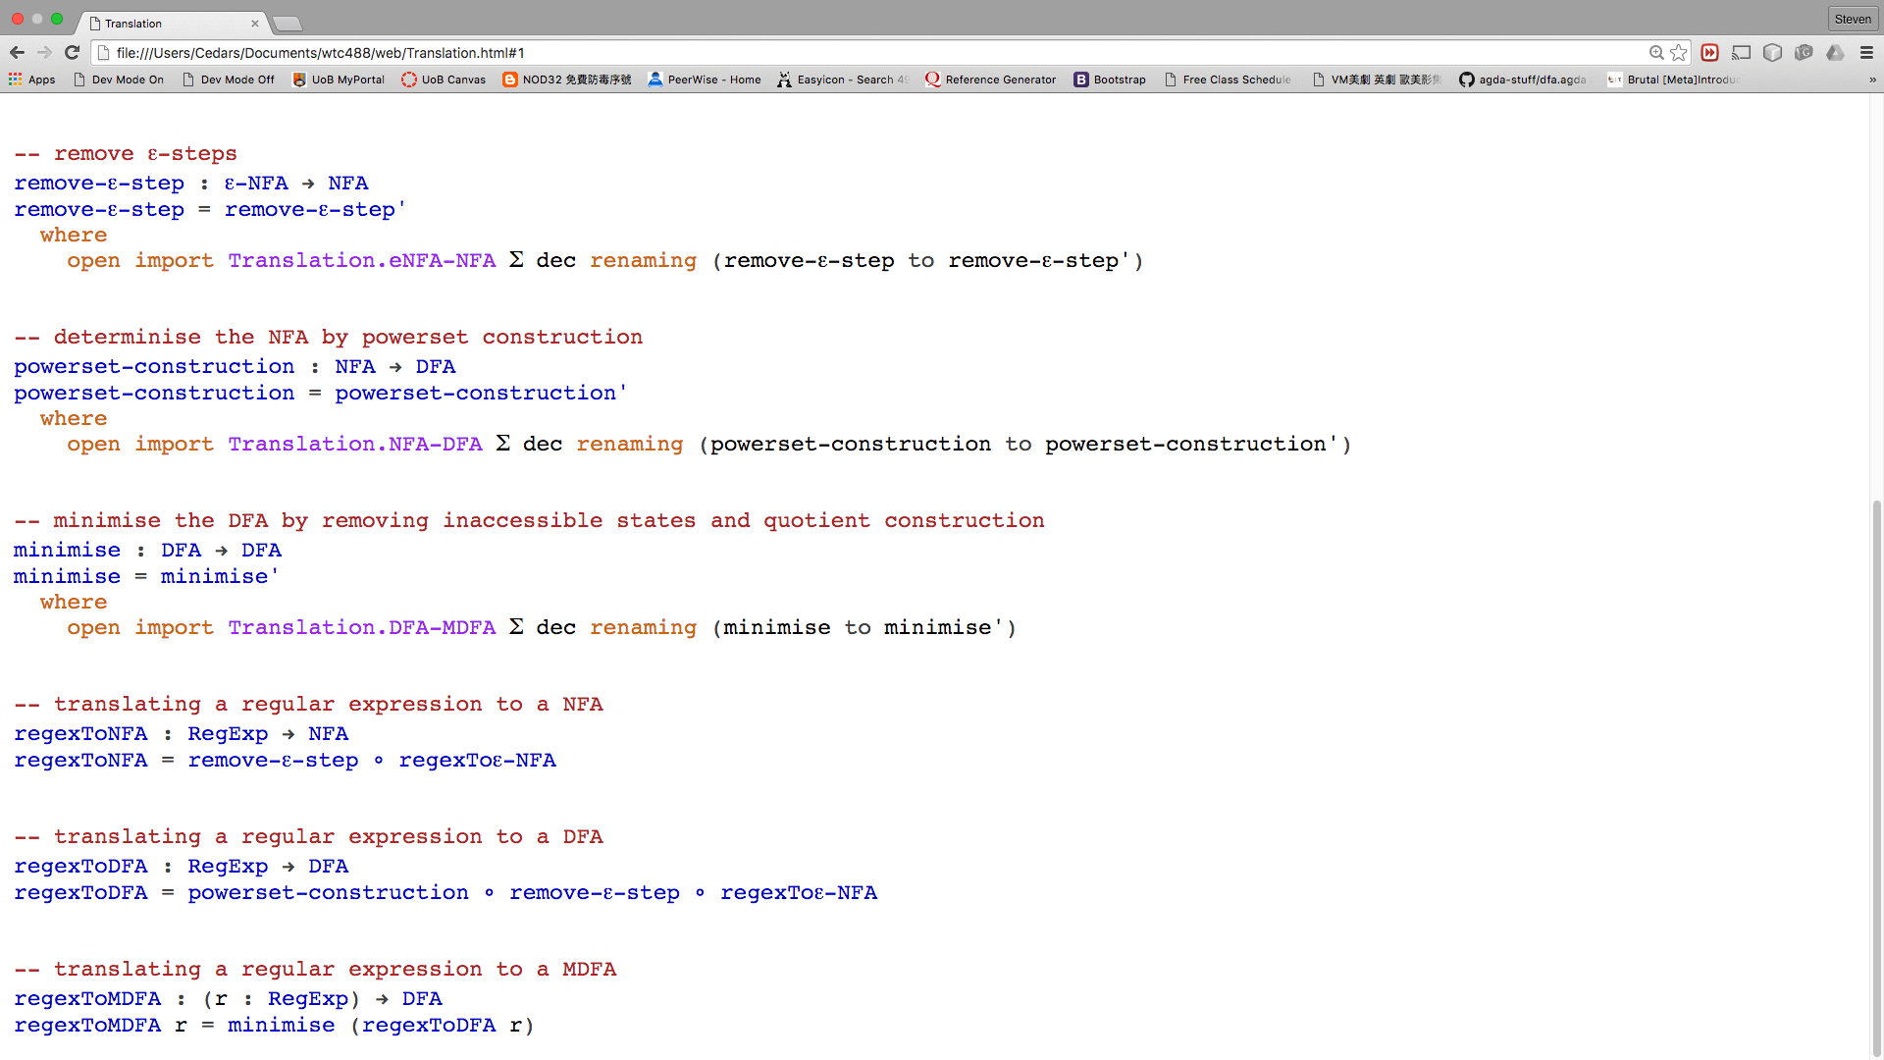
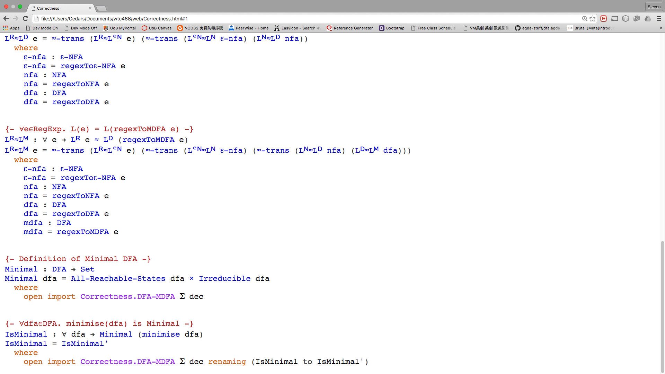
Formalisation

Slide 29
Regex → ε-NFA
Define Regular Expression
Define ε-NFA
Define the translation
Prove its correctness:
L(regex) = L(translated ε-NFA)

